Slide 1
Applications of Latent Class Mixed Models in CF Infant Airway Microbiomes
Casey Sakamoto
Committee: Brandie Wagner, Jonathan Harris, Elizabeth Juarez-Colunga

Slide 2
Cystic Fibrosis (CF)
Hereditary disease which involves production of mucus which is much more viscous than usual
Early airway vulnerability to chronic bacterial infections
Most common life-threatening autosomal recessive disease in US
Affects 1 in 4000 newborns
No known cure
Notes:
Slide Purpose: Background info on CF- what is it, who does it affect
Mucus is difficult to expel from lungs
(3)All newborns (US) screened for CF
(4) Higher rates in some European countries

Slide 3
Cystic Fibrosis (CF) cont.
Subjects have varied disease progression
Unclear whether variability present in early CF airways, or if it develops over time
Identifying endotypes based on airway microbiome community composition may clarify this
Microbiome data complex
Notes:
Slide Purpose: Background info on CF- motivate analysis of the microbiome
Better understanding of early airway infections -> better understand variability of disease progression

Slide 4
Microbiome Data
Requires consideration of location & quantity of samples
Number of samples collected could often be limited
Sequencing of a specimen provides estimate of the relative abundance of different species within a sample
Potential lack of measurement precision provides some difficulty in conclusions drawn
Relative Abundances sum to 1; many standard statistical methods inappropriate here
Notes:
Slide Purpose: Insight into complexity of microbiome data
mention how microorganisms on/in the human body outnumber human cells tenfold, Can be used to identify diff between members of a family, community, or across different popns
Left:
Are our samples representative of our population (true mb comp); could it change based on location of sample (upper vs lower airways)
Limited based on difficulty of collecting the samples (is the procedure invasive? Is Location precision important?)
Right: pearson’s correlation coefficient, ANOVA, linear regression, t-tests

Slide 5
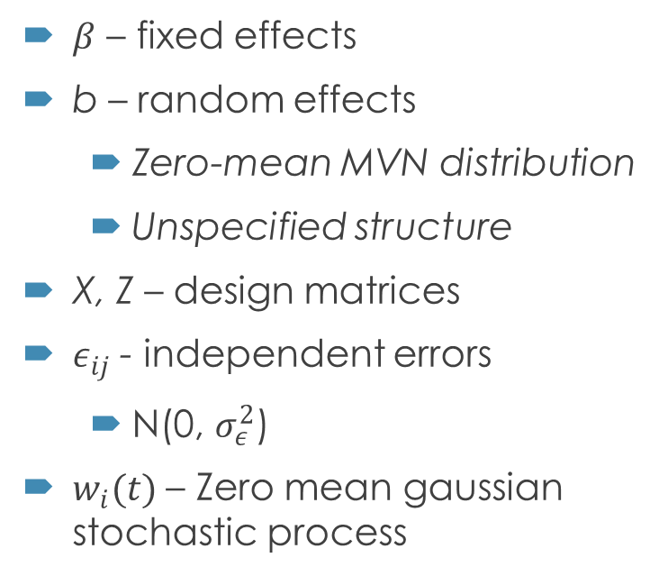
Building a Latent Class Mixed Model: Linear Mixed Model recap
$β$ – fixed effects
b – random effects
Zero-mean MVN distribution
Unspecified structure
X, Z – design matrices
$ε_{ij}$ - independent errors
N(0, $σ_{ε}^{2}$)
$w_{i}(t)$ – Zero mean gaussian stochastic process
Assume normally distributed measurement errors, random effects, correlated errors
Assume constant covariate effects across time
Notes:
SP: recap LMM
For subject i, repeated measure j
Design matrix trajectory shapes can be of any type (polynomial, specifically designed to the fit, spline methods)
w(t) ZM gaussian stoch process or stationary process w parameter $σ_{w}^{2}$; included in semiparametric lmm, used to model serial correlation

Slide 6
Latent Class Analysis: A “Classy” Take on Microbiome Data
The latent class mixed model is a sub-genre of structural equation modeling
Very similar to cluster analysis
Incorporates a linear mixed model framework into the modeling of unmeasured groups (endotypes) to fit longitudinal data
Notes:
SP: introduce the method & a general connection to the main thesis question
(3) Mention the unmeasured groups are the latent variables, will explain in a bit

Slide 7
Latent Class Analysis: A “Classy” Take on Microbiome Data
Application of Latent Class Analysis methods to microbiome still relatively novel
Especially longitudinal airway microbiome data
Few assumptions on the data; appealing for microbiome data
Normality assumption can be met via compositional transformations
Notes:
Slide purpose: to present LCA as a method of analyzing mb data
Several papers have emphasized the utility of building these models (in tangential areas of interest of the microbiome: true bacterial community composition, identifying phenotypes, Bayesian versions of SEM)
Hasn’t really been any applications applying lcmm to longi mb data (very novel application)
Really, the only main assumption is the outcomes are norm dist

Slide 8
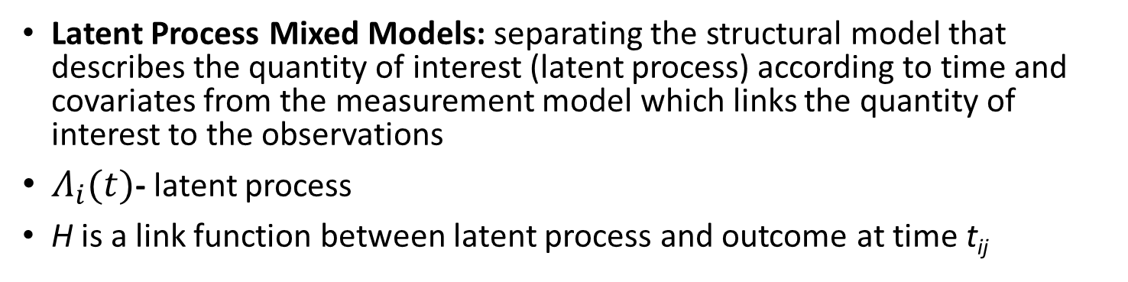
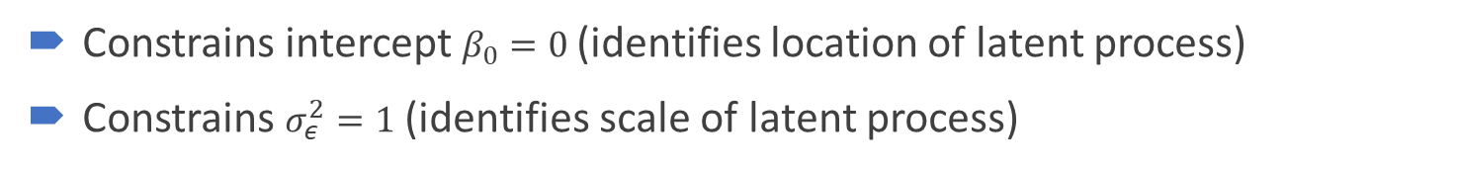
Building a Latent Class Mixed Model: Latent Process Mixed Model
Latent Process Mixed Models: separating the structural model that describes the quantity of interest (latent process) according to time and covariates from the measurement model which links the quantity of interest to the observations
$Λ_{i}(t)$- latent process
H is a link function between latent process and outcome at time t_{ij}
Constrains intercept $β_{0}=0$(identifies location of latent process)
Constrains $σ_{ε}^{2}=1$ (identifies scale of latent process)
Notes:
SP: introduce a latent model
Latent process- standard lmm w/o error
Several options for H in package lcmm, but we are going to opt for a compositional transform on the outcome instead

Slide 9

Building a Latent Class Mixed Model: Latent Process Mixed Model
Extended to Multivariate case with K longitudinal markers (such as bacterial taxa)
Similar constraints as in univariate case
Also requires a random intercept
Notes:
SP: multivariate case
Requires random intercept, because the dimension of the latent process constrained by intercept (B0=0) and variance of random intercept rather than se of a marker specific standard error

Slide 10
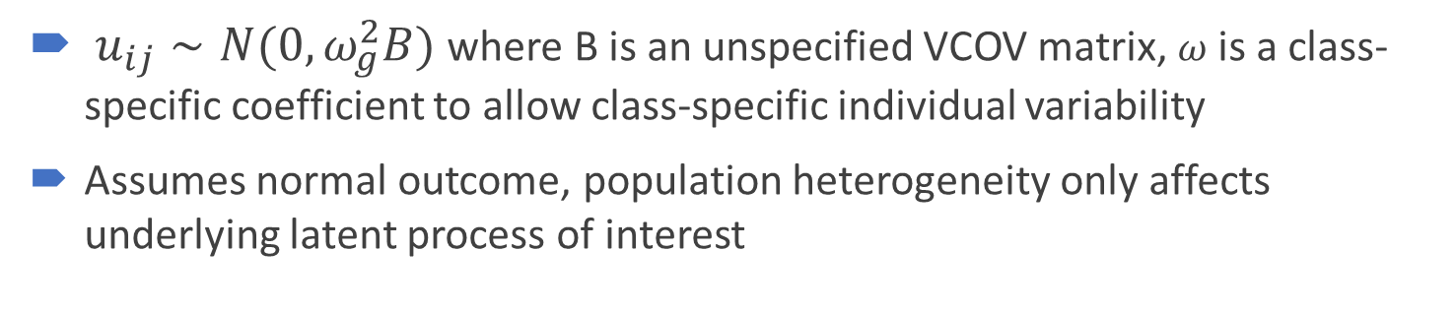
Building a Latent Class Mixed Model: Latent Class Mixed Model
Assume a heterogenous population with G latent classes of subjects (each subject belongs to one class)
C_{i} is a discrete random variable; P(C_{i} = g) is class-specific probability
$u_{ij}∼N(0,ω_{g}^{2}B)$ where B is an unspecified VCOV matrix, $ω$ is a class-specific coefficient to allow class-specific individual variability
Assumes normal outcome, population heterogeneity only affects underlying latent process of interest
Notes:
SP introduce the method to be used in the thesis
Linear mixed model for a normal outcome Yij in class g
This is extended to a latent process model

Slide 11


Building a Latent Class Mixed Model: Parameter Estimation
Individual contribution to the likelihood of LCMM:
Fixed effects, Random effects, Variance of random process, variance of errors, P(c = g), $ω$ all need to be estimated
Package lcmm maximizes log-likelihood using extended Marquadt algorithm with conservative convergence criteria
Notes:
SP: define parameters estimated, how they are estimated, likelihood form
Marquadt algorithm in family of newton Raphson
Convergence of log lik based on 3 criteria: stability of log lik, stability of parameters, size of derivatives (important we have three because some likelihood shapes can be quite flat in certain areas of param space)

Slide 12
Motivating example: BONUS STUDY
Goetz et al. (2019) analyzed data from 231 infants within 28 centers in the US in the Baby Observational and Nutritional Study (BONUS) which was comprised of clinical, medication, symptoms, culture, and chest radiographs data collected repeatedly throughout the first year of life. Over 1,000 throat swabs were collected from 205 infants over the first year of life.194 infants (84%) developed a CF specific pathogen , and there was a relatively low number of taxa within the collected samples

Slide 13
The thesis
Identifying endotypes based on airway microbiome community composition may help elucidate whether infants start with a similar microbiome that changes over time or are the observable differences in subject microbiomes due to inherent subject variability
How many latent classes are there; can we build these classes using Latent Class Analysis
When we build these classes what covariates are associated with our clusters?

Slide 14
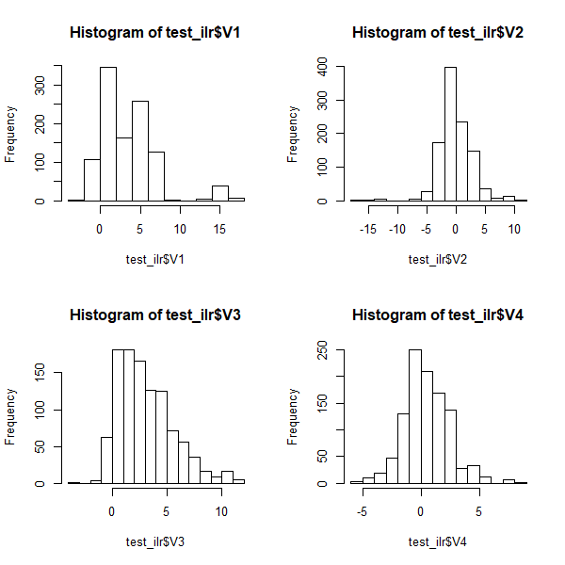
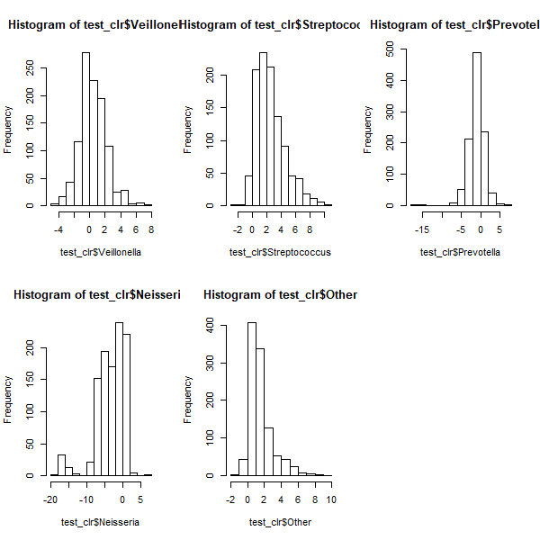

Methods: Data Manipulation
Data grouped into 5 genera: Streptococcus, Veillonella, Prevotella, Neisseria, and Other
The CLR transform of vector x is:
$$clr\left(x\right)=\ln{{\left(x\right)i}_{­}}− \frac{1}{D}\sum_{j=1}^{D}{ln(x_{j})}$$
The ILR transform of a vector x is:
$$ilr\left(x\right)=clr\left(x\right)V^{T}$$
Data were transformed in R using the compositions package.
Notes:
Slide Purpose: to show what methods were used to transform comp data into normal
1 relatively low number of taxa per subject; 550 unique overall; 4 groups had a factor of 10- 100 higher counts than the next highest group
2 Data were normalized using logratio transformations appropriate for compositional data. We evaluated both the centered logratio and isometric logratio transformations.
3 V^{T} is an orthonormal basis of the clr-plane

Slide 15
Methods: Models Fit
Preliminary Models
Model Selected
Both multivariate and univariate latent class
Minimum of either two or three observations per subject
Time as both continuous and discretized age
Linear trajectories and spline trajectories
Up to 10 latent classes
Models fit in R using the lcmm package
Model selected using a combination of AIC and maximum number of latent classes
Refit to include clinical covariates
Notes:
SP: to show things we considered in model selection and fitting
1 Multivariate models fit used ILR transformed data, while univariate models fit used only the CLR transformed Streptococcus group - due to model convergence issues
2 we need more than one if we are looking at trajectories over time, 3 min was considered for more interesting splines
3 month means we discretize the variable to a number (“which visit was it?”)

Slide 16
Methods: Covariate Model
Clinical covariates were examined in a second stage analysis for selection to put into the model
The covariates fit in the final model included sex, genotype, meconium ileus, antibiotic use*, feeding type, and subject growth.
Weight Z-Score was used to portray growth rather than height because of a higher correlation with the outcome.
A 0.1 significance level was used to determine association with the clusters.
Notes:
age of first antibiotic use, whether the subject was currently on antibiotics, number of antibiotics the subject was currently on, cumulative antibiotics days

Slide 17
Results: Models Considered
Transformation
Trajectories
Several multivariate ILR models
Most multivariate CLR did not converge.
Streptococcus CLR univariate models fit
Linear trajectory models typically converged, while some spline trajectory models did not.
When both trajectory models converge the spline models fit better.
Notes:
Recall: Preliminary models were fit considering minimum number of observations required for infant inclusion, multivariate versus univariate genera outcomes, normalizing transformations (CLR versus ILR), latent class trajectory types (linear versus spline) and time (continuous versus categorical).
Mention that tried several combinations of clr groups, but 2 groups or fewer converged, settled on strep

Slide 18
Results: Models Considered
Minimum Observations
Time Measurements
Out of 205 subjects, 5 had 1 sample and 8 had 2 samples
3 sample minimum models had a better fit than those using a minimum of 2
Continuous age and integer age measurements yielded similar results
Age as an integer was used for simplicity

Slide 19
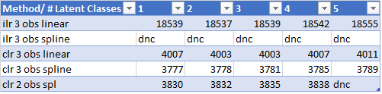
Results: Models Considered
Models which converged typically converged up to between 4-6 latent classes
For all models fit the model with a single latent class was typically best fit by AIC

Slide 20
Results: Model Chosen
Univariate CLR transformed Streptococcus model with spline trajectories and 4 latent classes
Lowest AIC across other models considered
Maximum # latent classes while still maintaining AIC “close” to the single latent class model
Notes:
Mention how we used ~10 AIC as a criteria, but that our selection was more looking at lowest aic across models then maximizing the # lc
Transition to alluvial plot

Slide 21
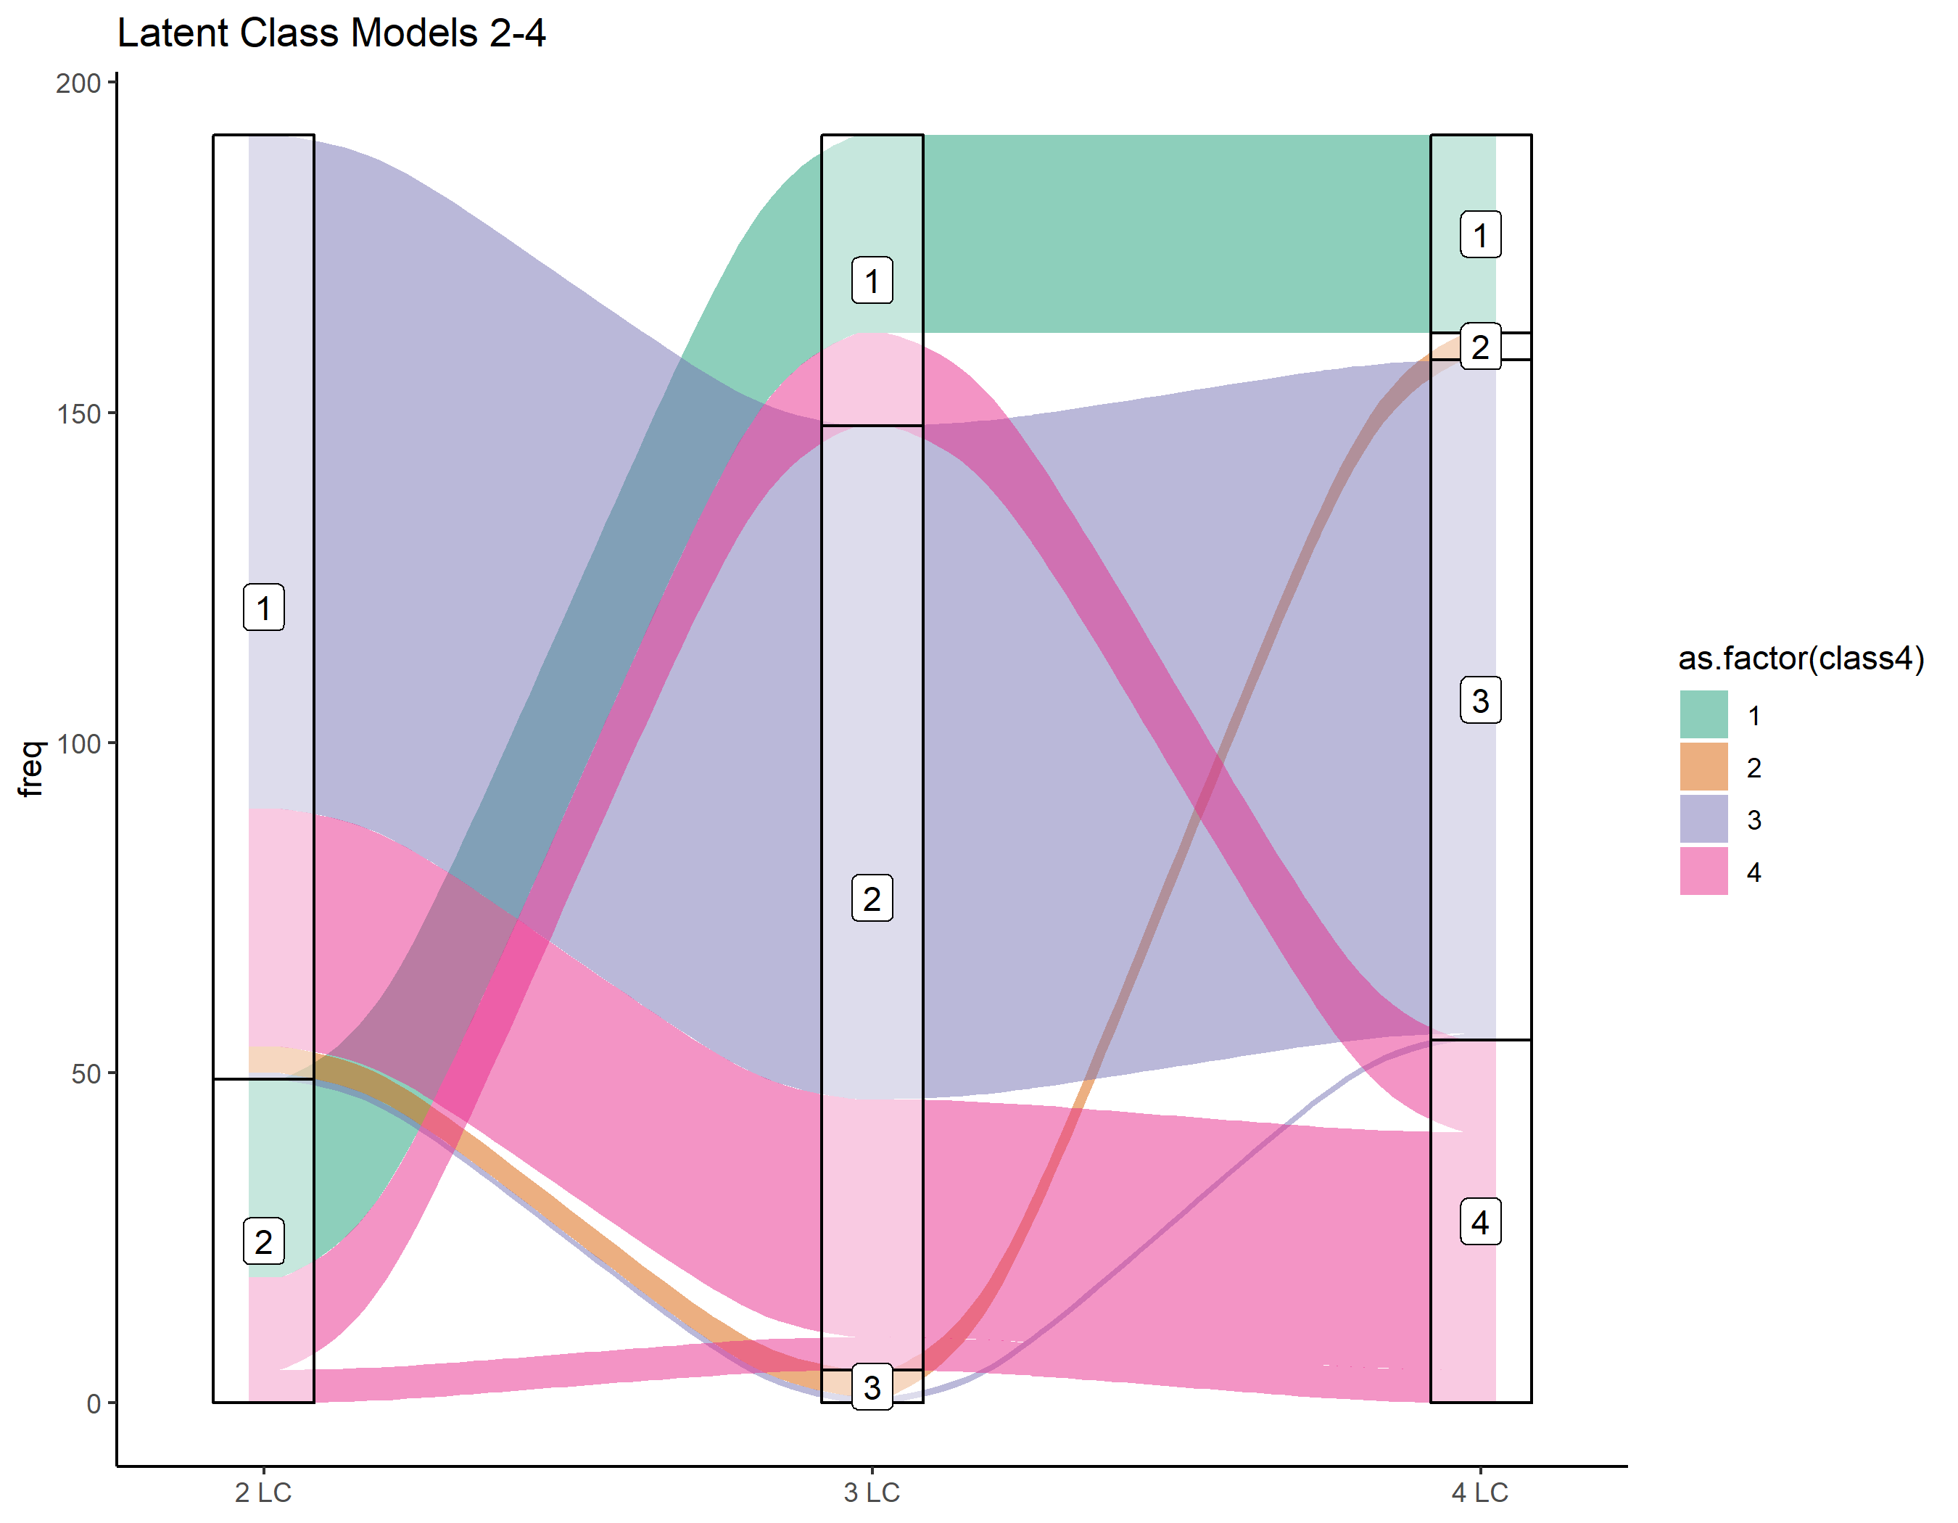
Results: Model Chosen
Classes 2, 3, and 4 in our chosen model seem to come from splitting up the larger class in 2 latent class case
Class 1 seems to come from the smaller class
Chosen Model
Notes:
Alluvial plot which shows how the subjects were classified in the multiple latent class models yaxis is # of subjects
Comparison of similar models with different number of latent classes indicate that classes 2, 3 and 4 seem to come from splitting up the larger class in the 2 latent class case, while the majority of class 1 contains the same subjects as the smaller class in the 2 latent class case

Slide 22
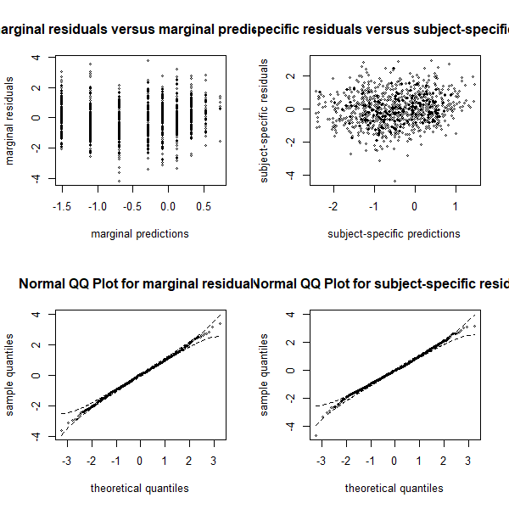
Results: Model Fit
Residuals look evenly centered around 0
Possible divergence from normality at extreme values in sample
Notes:
residuals

Slide 23
Results: Model Fit of Chosen Model
Posterior Classification Table
 | Probability Class 1 | Probability Class 2 | Probability Class 3 | Probability Class 4
Class 1 | 0.80 | 0.00 | 0.02 | 0.18
Class 2 | 0.00 | 0.79 | 0.21 | 0.00
Class 3 | 0.01 | 0.05 | 0.71 | 0.23
Class 4 | 0.19 | 0.00 | 0.23 | 0.58
Mean of posterior probabilities in each class
Subjects classified “a posteriori” in each class
High diagonal values indicate unambiguous classification
Notes:
High diagonal indicates that the model discriminates well with the fourth latent class seeming to be the most ambiguous class with some uncertainty of distinguishing from subjects within classes 1 and 3.

Slide 24
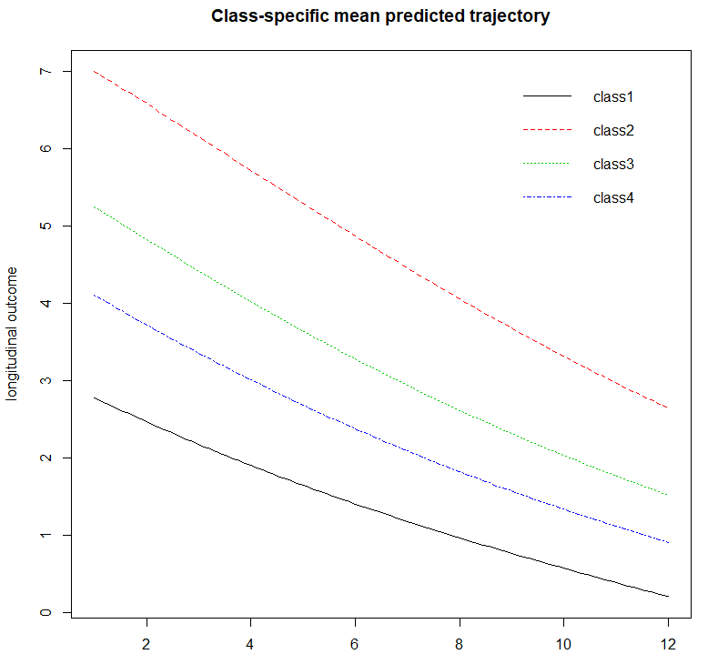
Results: Describing the latent classes
Decreasing trend of Streptococcus over time
Class 1 (n = 30): Lowest initial average relative abundance
“Loses” Strep within first year
Class 2 (n = 4): Highest initial average RA
Class 3 (n = 103): Most constant decrease besides Class 2
Class 4 (n = 55): More curved than other classes
Notes:
the smallest class (class 2) starts higher and tends to retain a higher than average relative abundance.
The largest class (class 3) demonstrates an average relative abundance over time whereas classes 1 and 4 have below average relative abundance for Streptococcus that remains low over time.
Note: classes 2,3,4 come from the larger group in the 2 lc models, while class 1 comes from the smaller group.

Slide 25
Results: Covariates
Infants in class 2 have a significantly higher initial relative abundance compared to class 1

Slide 26
Discussion

Slide 27
Discussion: LCMM package
Notes:
Mention how in the package lcmm it was easy to look at many different pieces of the model, from regular covariates to covariates associated with the latent classes themselves
Lots of models didn’t really converge (not sure if it’s the lack of data or the strict requirements on the algorithm)

Slide 28
Questions?

Slide 29
Works Cited

